Slide 1
BNFO 262 Module 4: Lecture 2 RNA-Seq: Differential Expression Analysis
Rob Morey, PhD
remorey@health.ucsd.edu

Slide 2
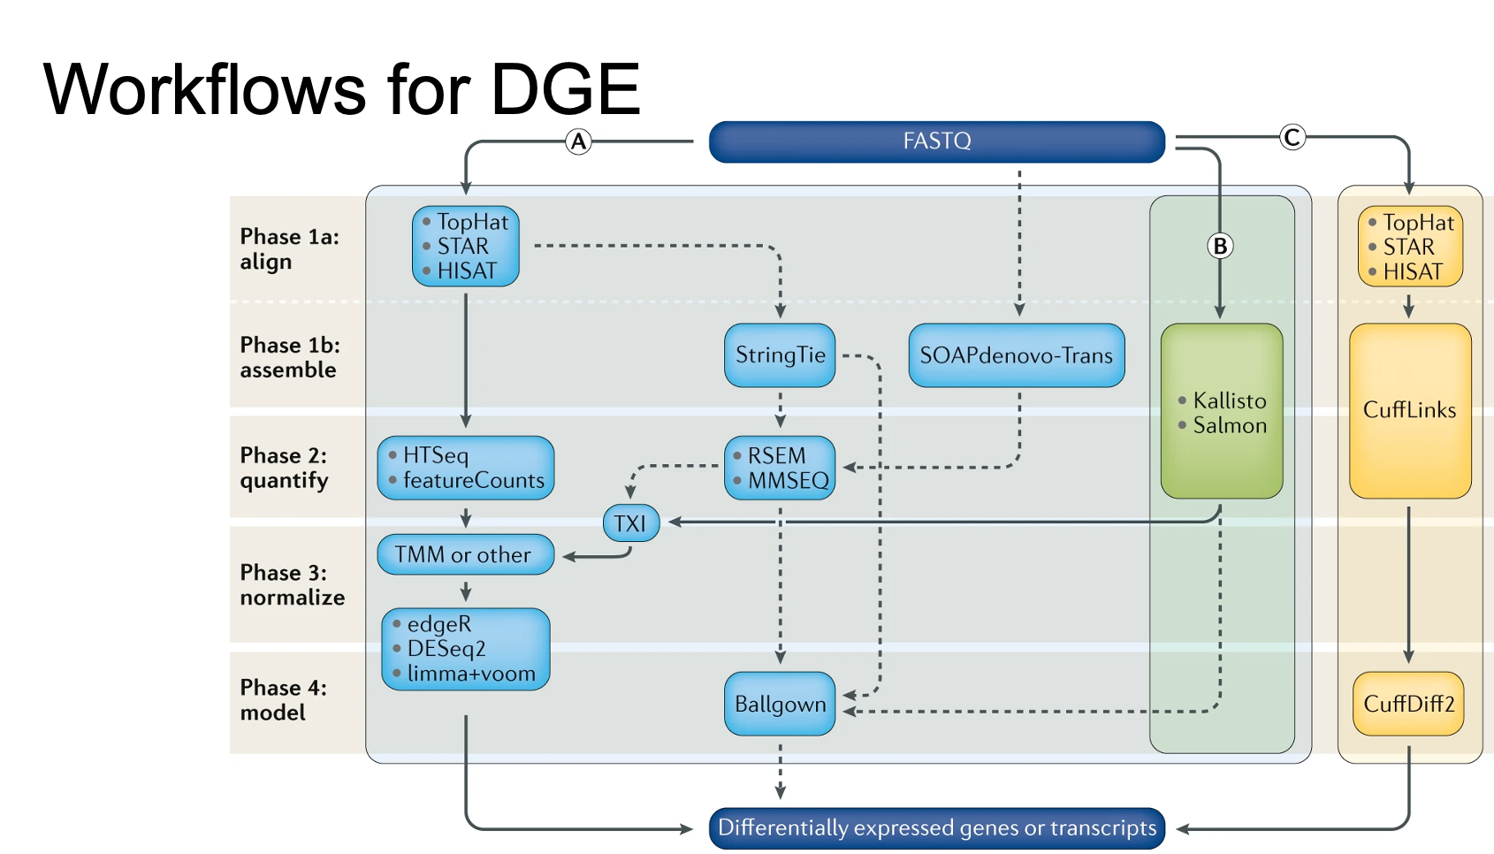

Slide 3
RNA-Seq: Workflow Overview Part 2
2. Data analysis
Filtering
Normalization
Statistical Analysis
Data Mining
Trimming
Alignment
Biological interpretation
Read counts
QC
Trimmomatic
cutAdapt
STAR
Salmon/Kallisto (alignment-free)
featureCounts (subread)
RSEM
HTSeq
FastQC, MultiQC
Samtools
DESeq2
EdgeR
Limma-Voom
BNFO 262 Winter 2026​
Notes:
https://wiki.illinois.edu/wiki/display/HPCBio/Fall+RNA-Seq+Workshop
https://rnaseq.uoregon.edu/#exp-design

Slide 4
Lecture Overview
Read normalization: CPM, RPKM, TPM
DESeq2 and edgeR
Exercise: DE analysis using mRNA counts data from Star and Salmon with DESeq2 and edgeR + TMM
Exercise: DE analysis using mRNA counts data with edgeR + TMM with limma-voom

Slide 5
Workflow: Functional Analysis
FASTQ
SAM/BAM
Counts Matrix Table
Raw reads
Quality control
Quality control
fastq
Adapter removal
fastq
Trimmed reads
fastq
Read mapping
sam/bam
Read quantification
table
Functional analysis
fastq
Alignment free quantification
table
BNFO 262 Winter 2026​

Slide 6
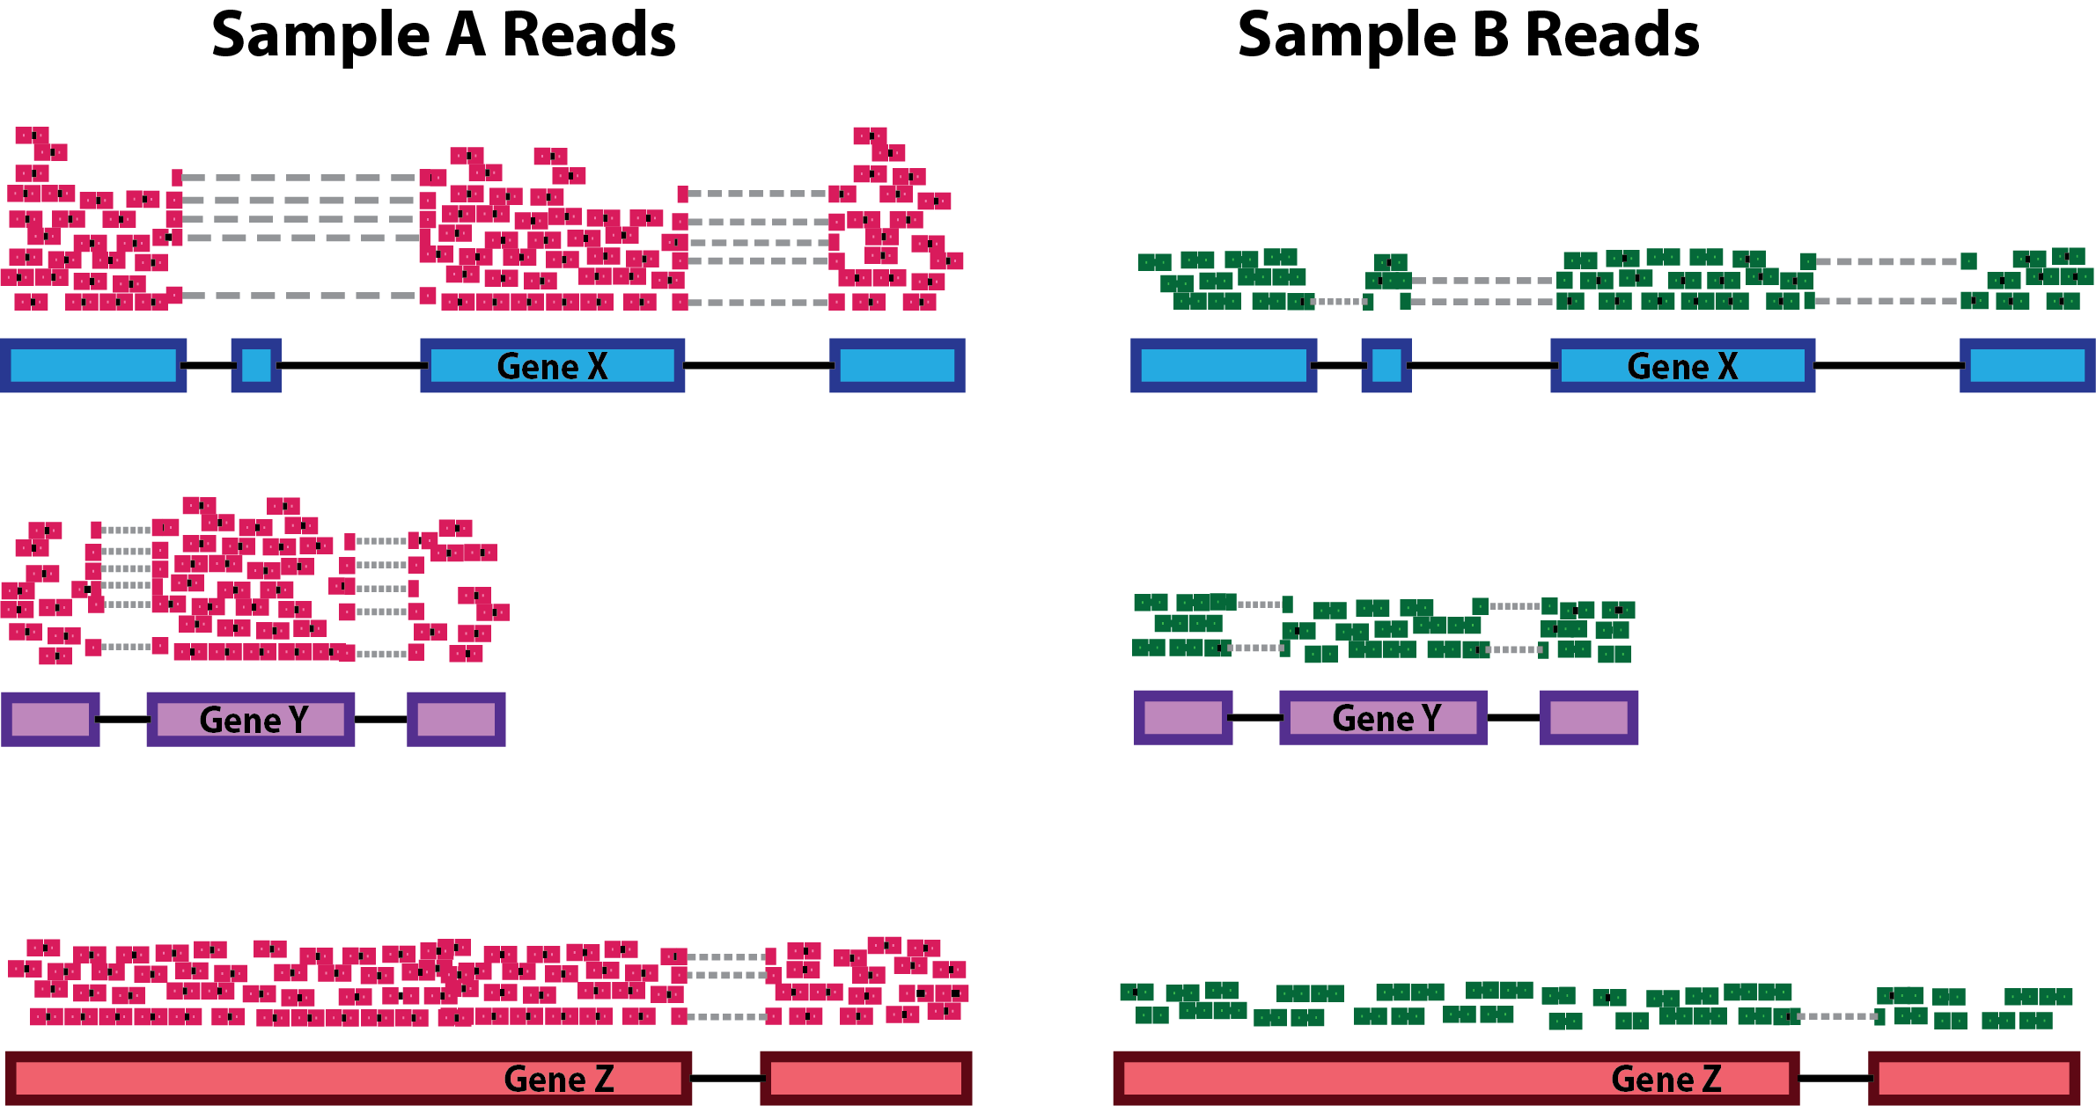
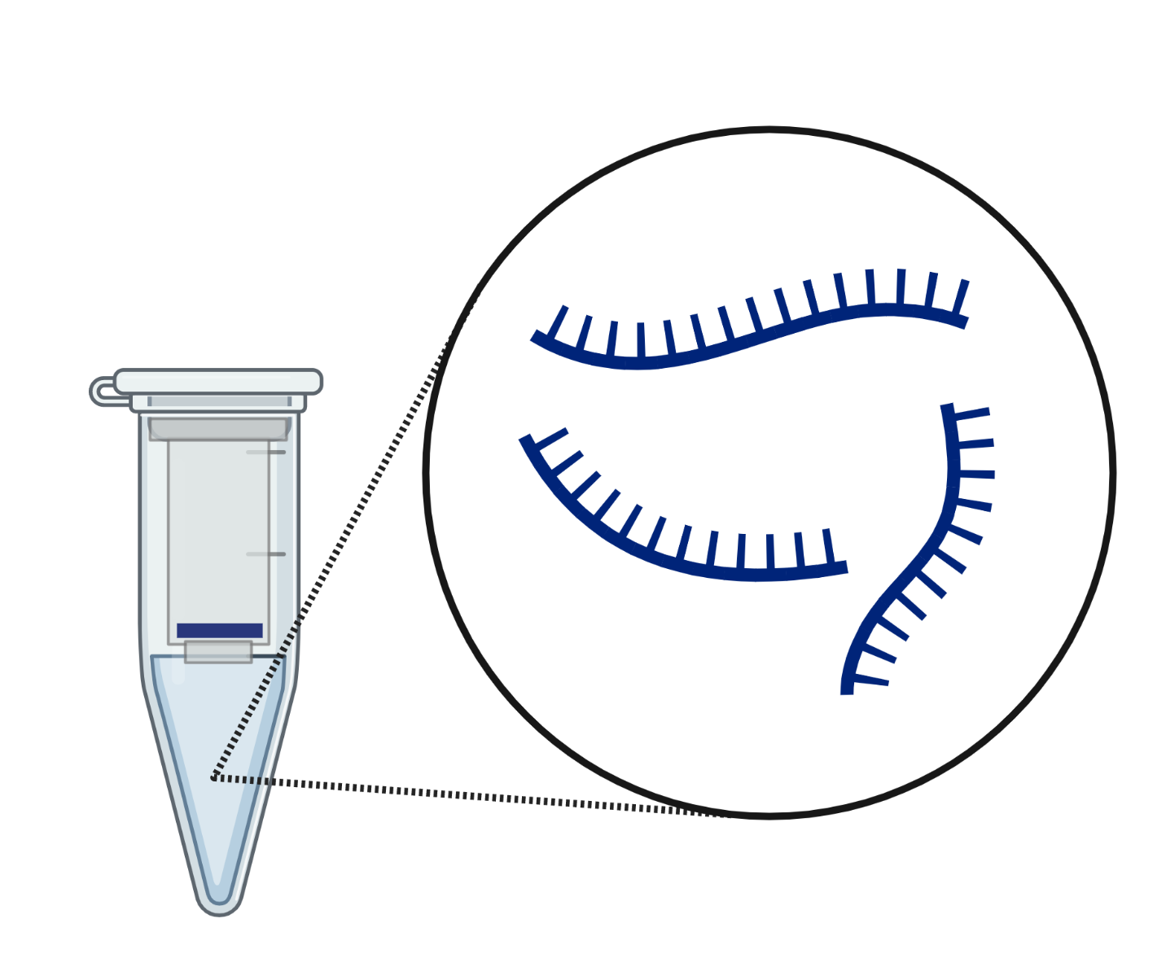
Why Normalize Reads?
RNA extraction
Replicates: Biological/technical
Read depth
BNFO 262 Winter 2026
Notes:
Figure BioRender
Figure: https://hbctraining.github.io/DGE_workshop/lessons/02_DGE_count_normalization.html

Slide 7
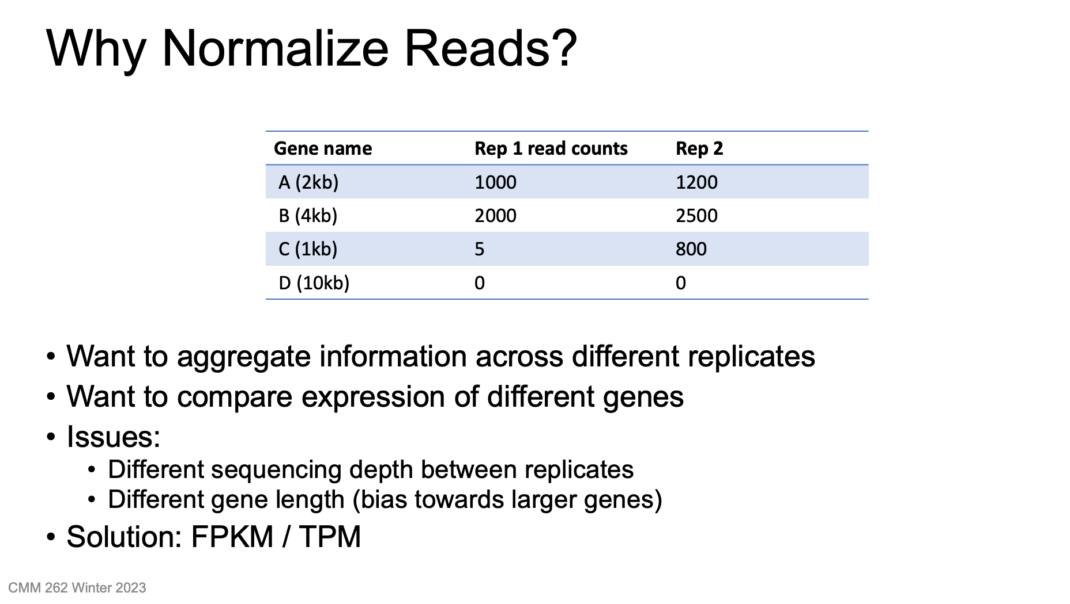
BNFO 262 Winter 2026
Notes:
Information:
http://www.rna-seqblog.com/rpkm-fpkm-and-tpm-clearly-explained

Slide 8
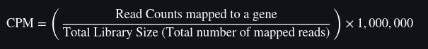
RPM/CPM
Reads per million or Counts per million
RPM or CPM =
Does not account for transcript length
OK to use for sequencing protocols where reads are generated irrespective of gene length
BNFO 262 Winter 2026
Notes:
Information:
https://www.reneshbedre.com/blog/expression_units.html#-gene-expression-units-and-calculation-

Slide 9
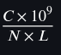
RPKM/FPKM
RPKM: Reads Per Kilobase of transcript per Million mapped reads
FPKM*: Fragments Per Kilobase of transcript per Million mapped reads
FPKM (or RPKM) attempts to normalize for gene size and library depth
FPKM =
C = Number of fragments mapped to a specific gene (for paired-end, a pair of reads mapping to the same fragment counts as one fragment).
10⁹ = A scaling factor that converts length to kilobases (10³) and library size to million reads (10⁶)
N = Total number of mapped fragments in the entire sample (library size).
L = Length of the gene or feature in base pairs (sum of exon lengths).
*Fragments can mean either individual reads (SE) or paired-end reads that map together (PE)
BNFO 262 Winter 2026

Slide 10
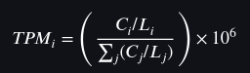
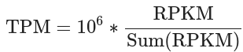
TPM
TPM: Transcripts per million (Transcripts Per Kilobase Million)
Another form of normalization for gene length and sequencing depth, but in the opposite order
TPM =
C_{i} = Raw read (or fragment) counts for gene i.
L_{i} = Length of the gene i in kilobases (kb)
Σ(C_{j}/L_{j}) = The sum of all length-normalized counts (RPK) across all genes in the sample.
BNFO 262 Winter 2026

Slide 11
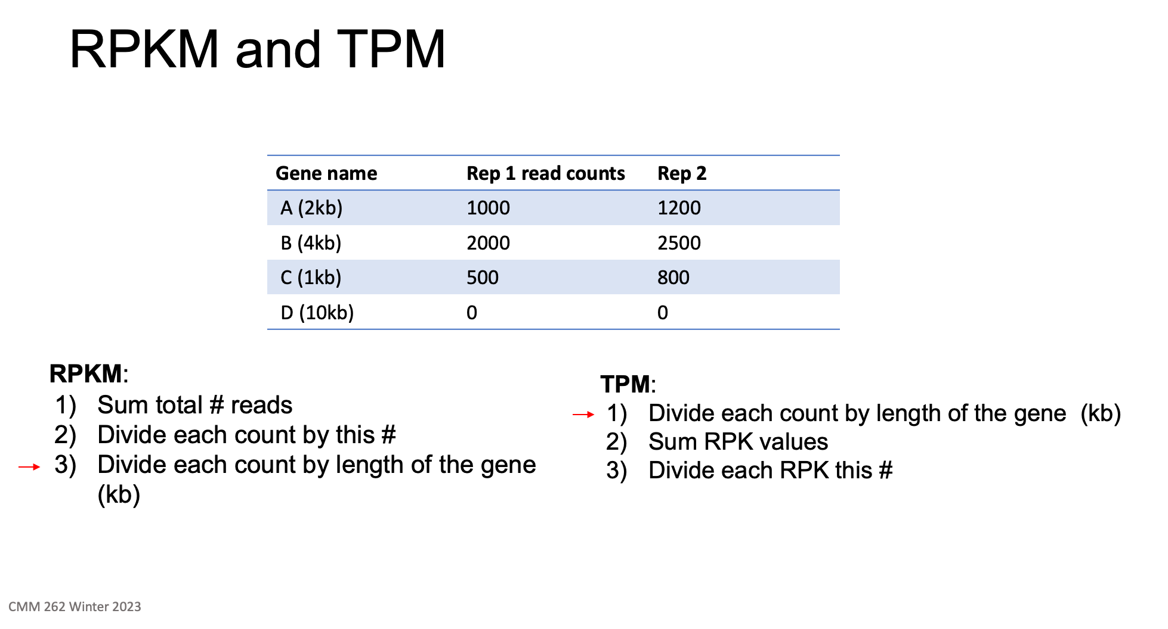
RPKM/FPKM normalizes for depth first then length of gene, whereas TPM normalizes for gene length first and then library depth.
BNFO 262 Winter 2026

Slide 12
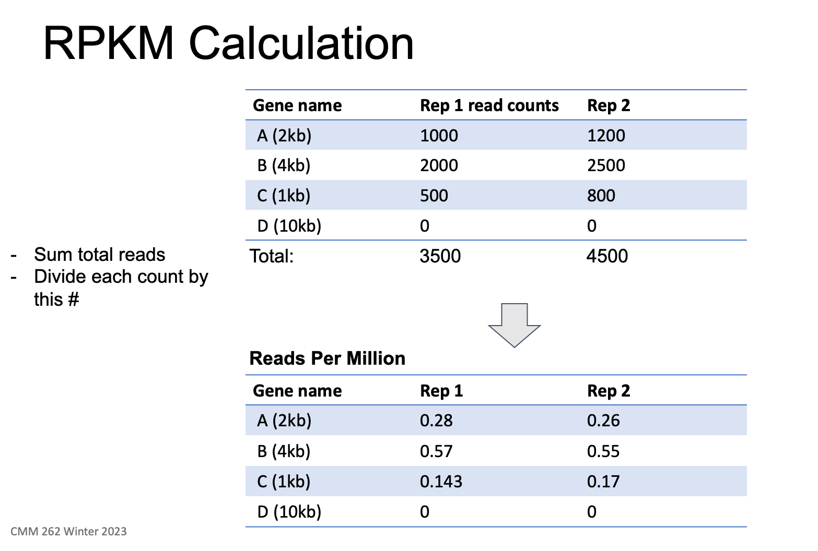
BNFO 262 Winter 2026

Slide 13
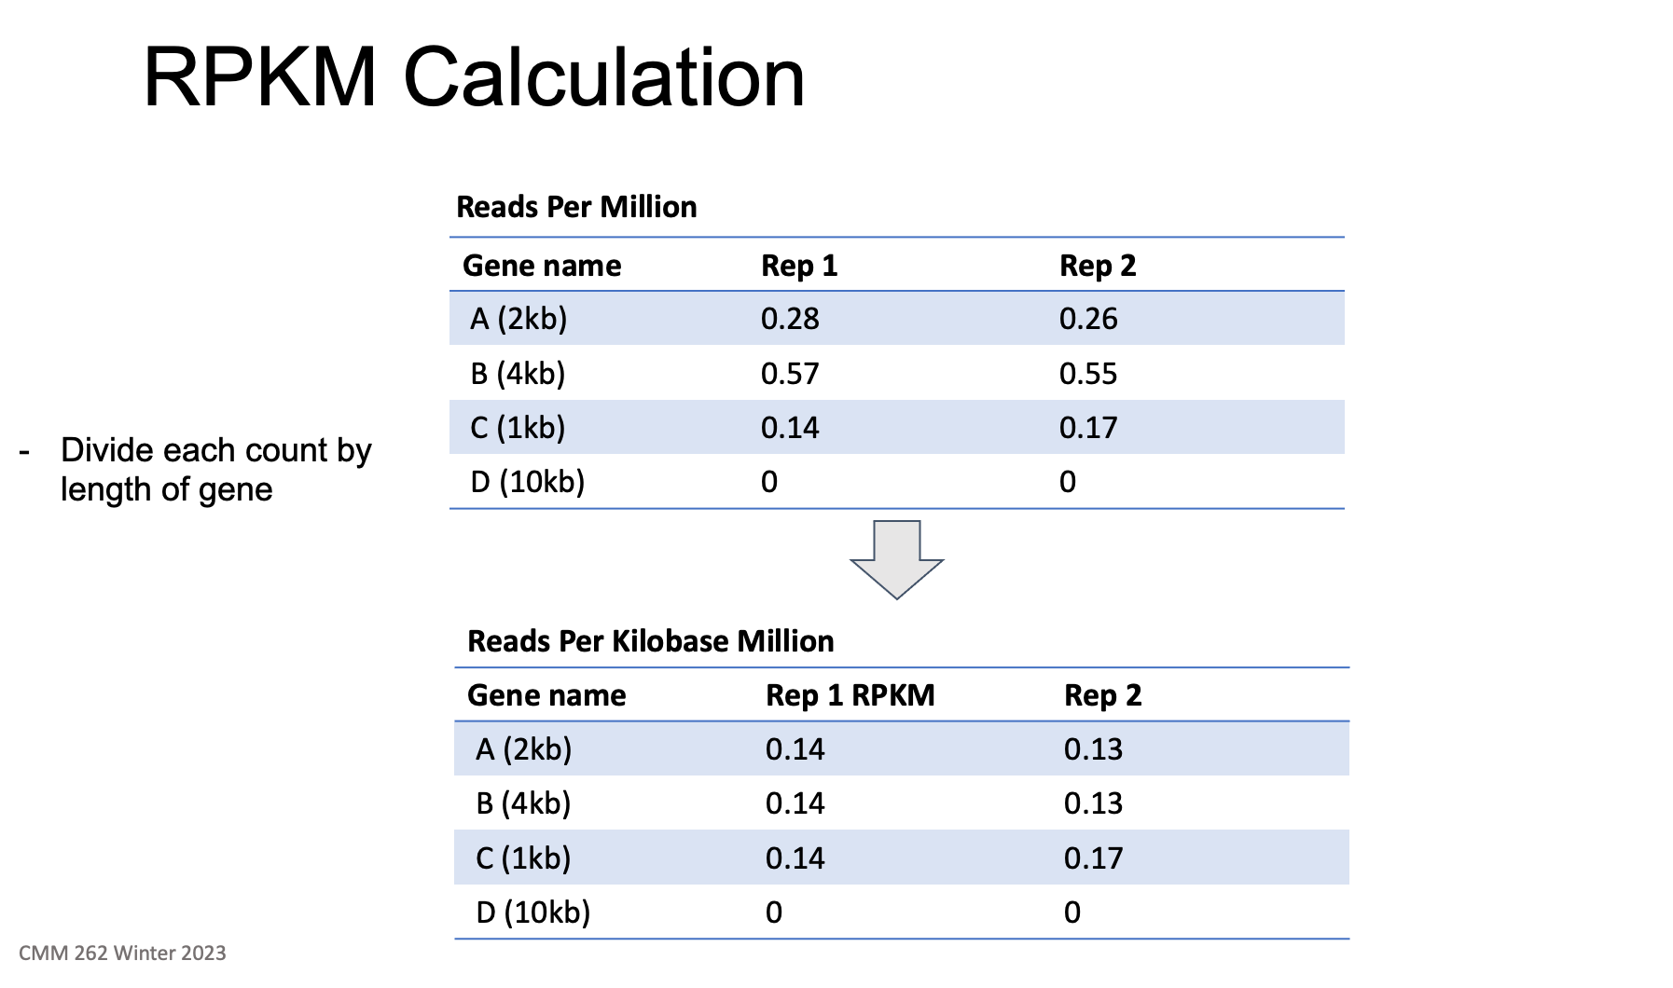
BNFO 262 Winter 2026

Slide 14
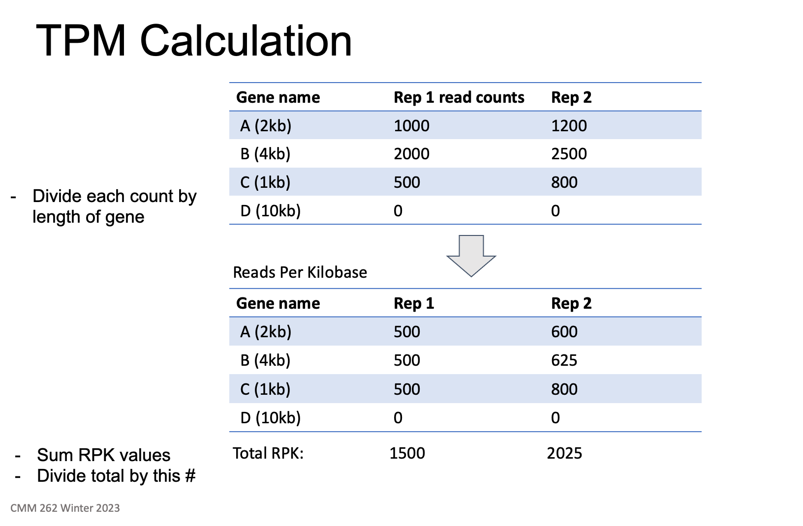
BNFO 262 Winter 2026

Slide 15
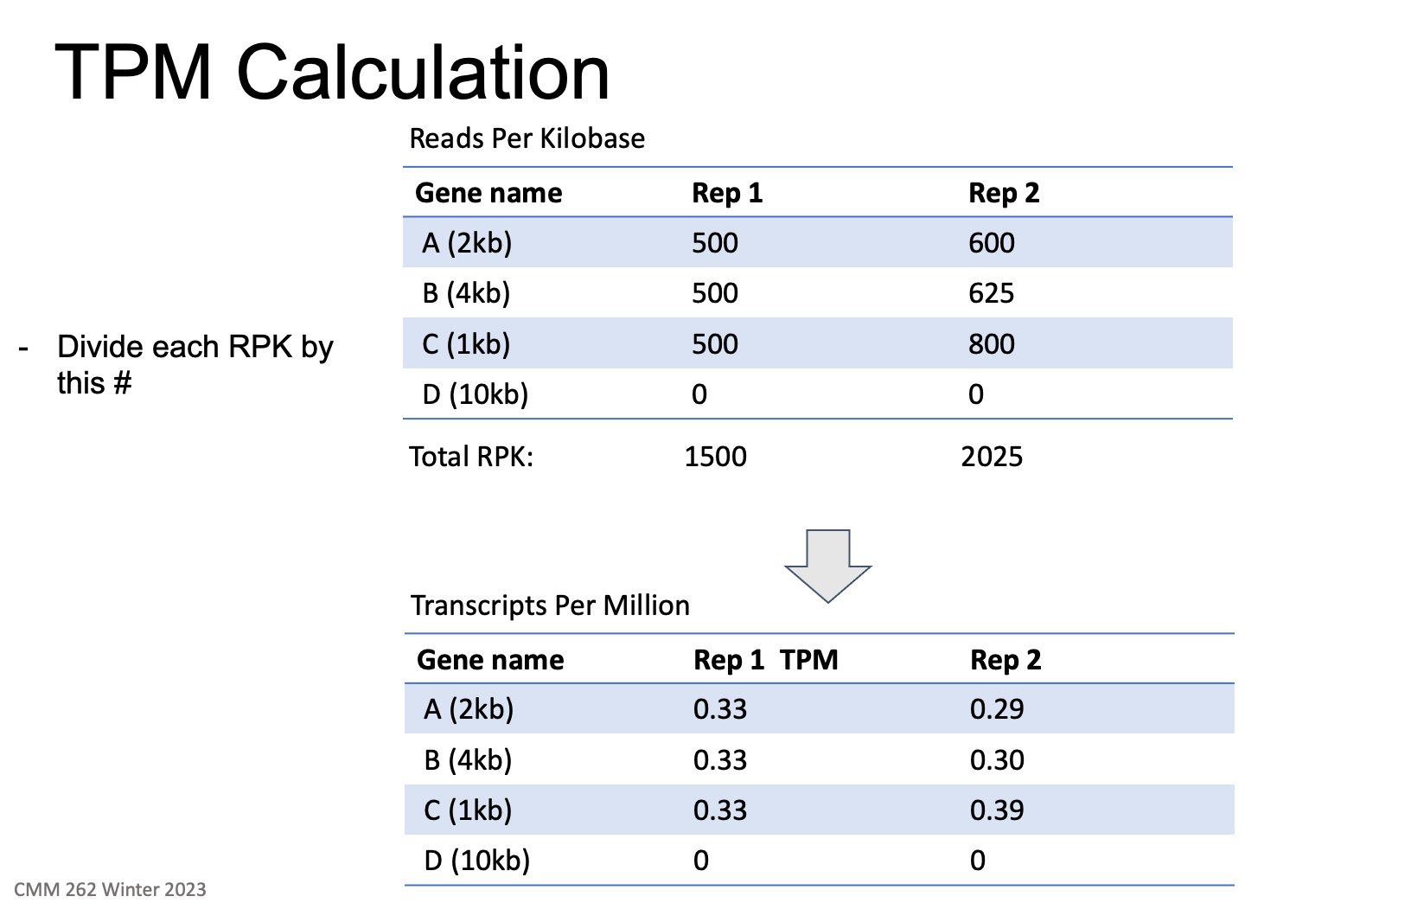
BNFO 262 Winter 2026

Slide 16
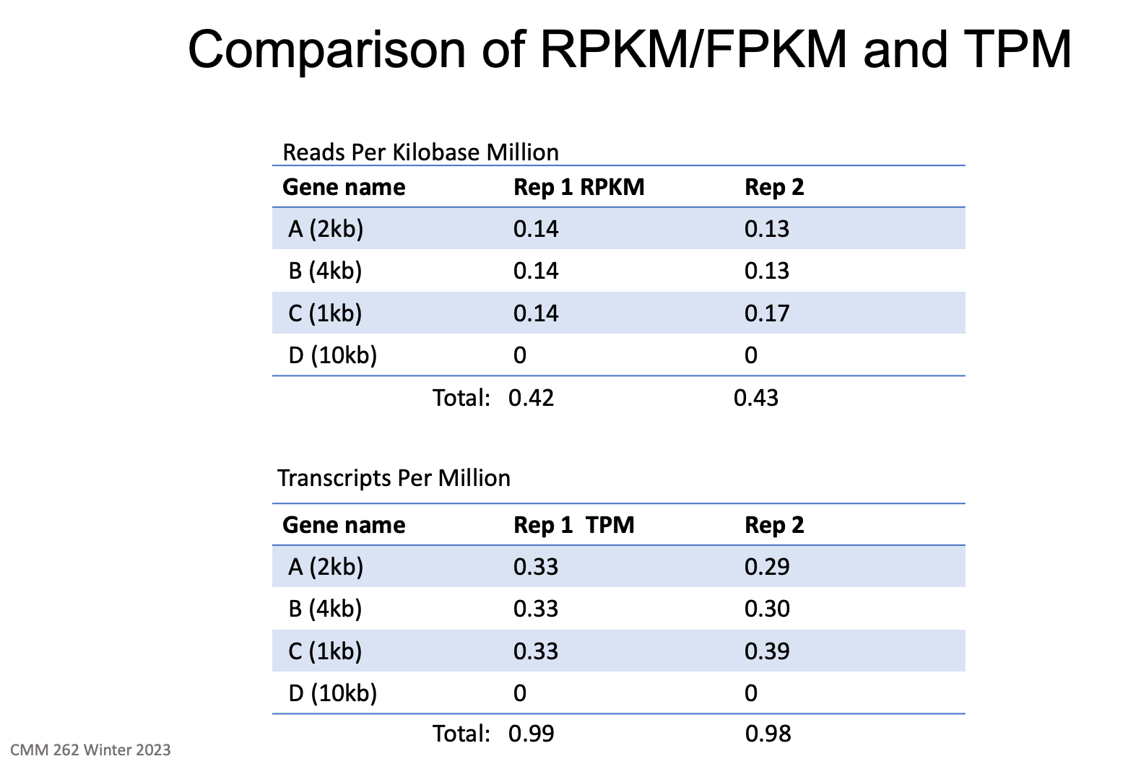
BNFO 262 Winter 2026

Slide 17
Summary
Both methods account for sequencing depth and gene length
RPKM / FPKM
compare genes within a sample
TPM
compare genes within a sample
compare genes between samples of the same sample group (only when there are equal total RNAs between compared samples and the distribution of RNA populations are close to each other)
TPM more common because FPKM/RPKM can be skewed by extreme gene length differences
DESeq2 performs its own normalization internally
edgeR: Different methods of normalization
BNFO 262 Winter 2026
Notes:
when calculating TPM, the only difference is that you normalize for gene length first, and then normalize for sequencing depth second. However, the effects of this difference are quite profound.
When you use TPM, the sum of all TPMs in each sample are the same. This makes it easier to compare the proportion of reads that mapped to a gene in each sample.
In contrast, with RPKM and FPKM, the sum of the normalized reads in each sample may be different, and this makes it harder to compare samples directly.
The direct comparison of RPKM and TPM across samples is meaningful only when there are equal total RNAs between compared samples and the distribution of RNA populations are close to each other.
FPKM values can appear different between samples even if the true expression level is the same. This is because FPKM values depend on the relative abundance of transcripts in a sample
Thus, under both natural and experimental conditions, the critical assumption that cells produce similar levels of RNA/cell between cell types, disease states or developmental stages is not always valid.
Its important to control for RNA extraction, library preparation, and RNA abundance when comparing samples.

Slide 18
RNA-Seq: Workflow Overview Part 2
2. Data analysis
Filtering
Normalization
Statistical Analysis
Data Mining
Trimming
Alignment
Biological interpretation
Read counts
QC
Trimmomatic
cutAdapt
STAR
Salmon/Kallisto (alignment-free)
featureCounts (subread)
RSEM
HTSeq
FastQC, MultiQC
Samtools
DESeq2
EdgeR
Limma-Voom
BNFO 262 Winter 2026​
Notes:
https://wiki.illinois.edu/wiki/display/HPCBio/Fall+RNA-Seq+Workshop
https://rnaseq.uoregon.edu/#exp-design

Slide 19
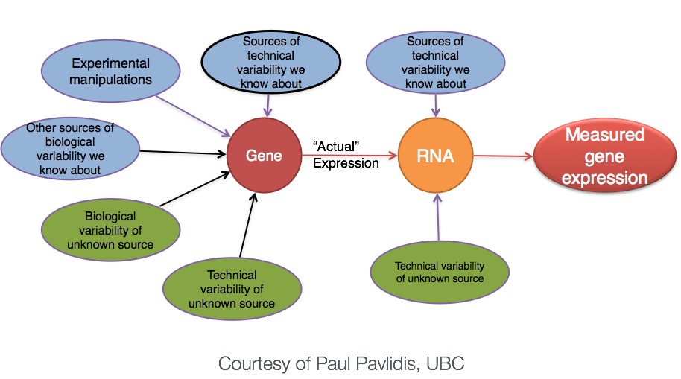
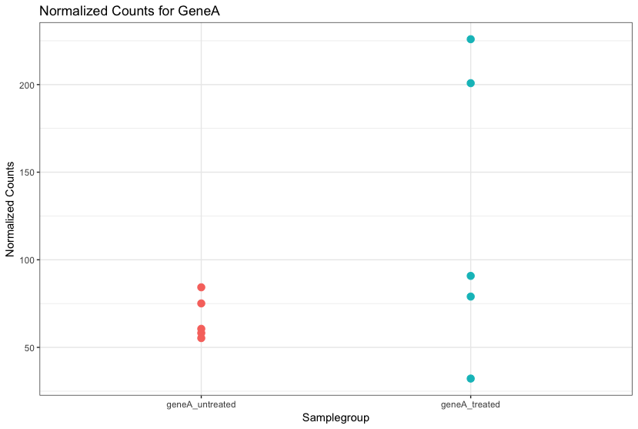
Differential Expression Analysis (DEA)
Goal: Identify and correct for sources of variation so that we can separate the "interesting" (biological/experimental) from "uninteresting" (technical)
BNFO 262 Winter 2026
Notes:
The mean expression level of GeneA for the ‘treated’ group is twice as large as the mean expression level for the ‘untreated’ group. But is the difference in expression between groups significant given the amount of variation observed within groups (across replicates)?
It is possible that the difference is not actually significant. We need to take into account the variation in the data (and where it might be coming from) when determining whether genes are differentially expressed.
Source: https://hbctraining.github.io/DGE_workshop_salmon_online/lessons/01c_RNAseq_count_distribution.html

Slide 20
DESeq2 and edgeR
Programs for differential gene expression (DE) analysis
Utilizes negative binomial model to model distribution of each gene
Assumes that most genes are not DE
Extensive documentation and examples available online
Documentation: https://bioconductor.org/packages/release/bioc/manuals/DESeq2/man/DESeq2.pdf
https://www.bioconductor.org/packages/release/bioc/vignettes/edgeR/inst/doc/edgeRUsersGuide.pdf
Examples: https://bioconductor.org/packages/release/bioc/vignettes/DESeq2/inst/doc/DESeq2.html
https://www.ncbi.nlm.nih.gov/pmc/articles/PMC4937821/pdf/f1000research-5-18347.pdf
BNFO 262 Winter 2026
Notes:
https://www.thoughtco.com/negative-binomial-distribution-4091991
The negative binomial distribution is a probability distribution that is used with discrete random variables. In a binomial distribution, you count the number of successes in a fixed number of trials, while in a negative binomial distribution, you count the number of trials needed to achieve a fixed number of successes. Binomial: Flipping a coin 10 times and counting how many heads you get. Negative binomial: Flipping a coin until you get 3 heads, and counting how many flips it took to reach that number of heads
In addition, this distribution generalizes the geometric distribution. Geometric distribution is a special case of a negative binomial distribution where you only need to wait for one success to occur.

Slide 21
DESeq2 and edgeR
Fundamental Assumptions
RNA-seq count data is best modeled by the negative binomial distribution
Most genes are not differentially expressed (DE)
DE and non-DE genes behave similarly
Balanced expression changes, that is, the number and magnitude of up- and down-regulated genes are comparable.
BNFO 262 Winter 2026

Slide 22
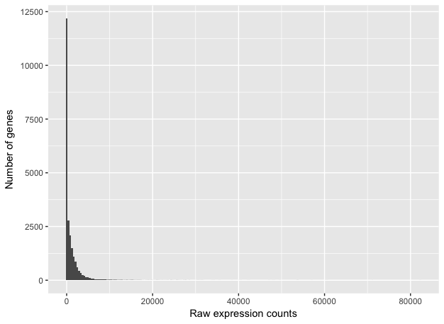
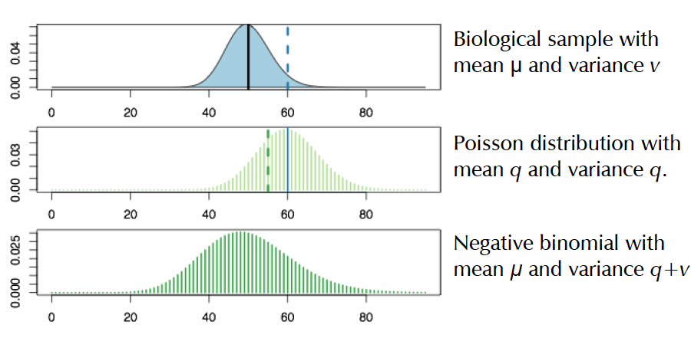
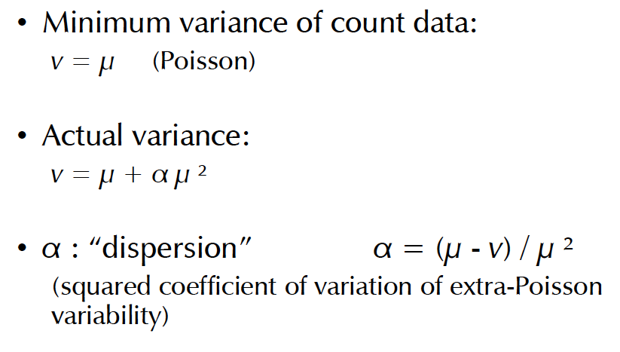
Modeling count data – why we don't still use the Poisson distribution
Poisson
Low number of counts associated with a large proportion of genes and a long right tail
Poisson: number of cases is large (total number of RNAs), and probability of an event is small (choosing any particular transcript)
BNFO 262 Winter 2026
Notes:
-Counts do not follow a normal distribution
-Poisson which assumes mean is equal to variance
-Variance refers to the spread between numbers in a data set. More specifically, variance measures how far each number in the set is from the mean and thus from every other number in the set

Slide 23
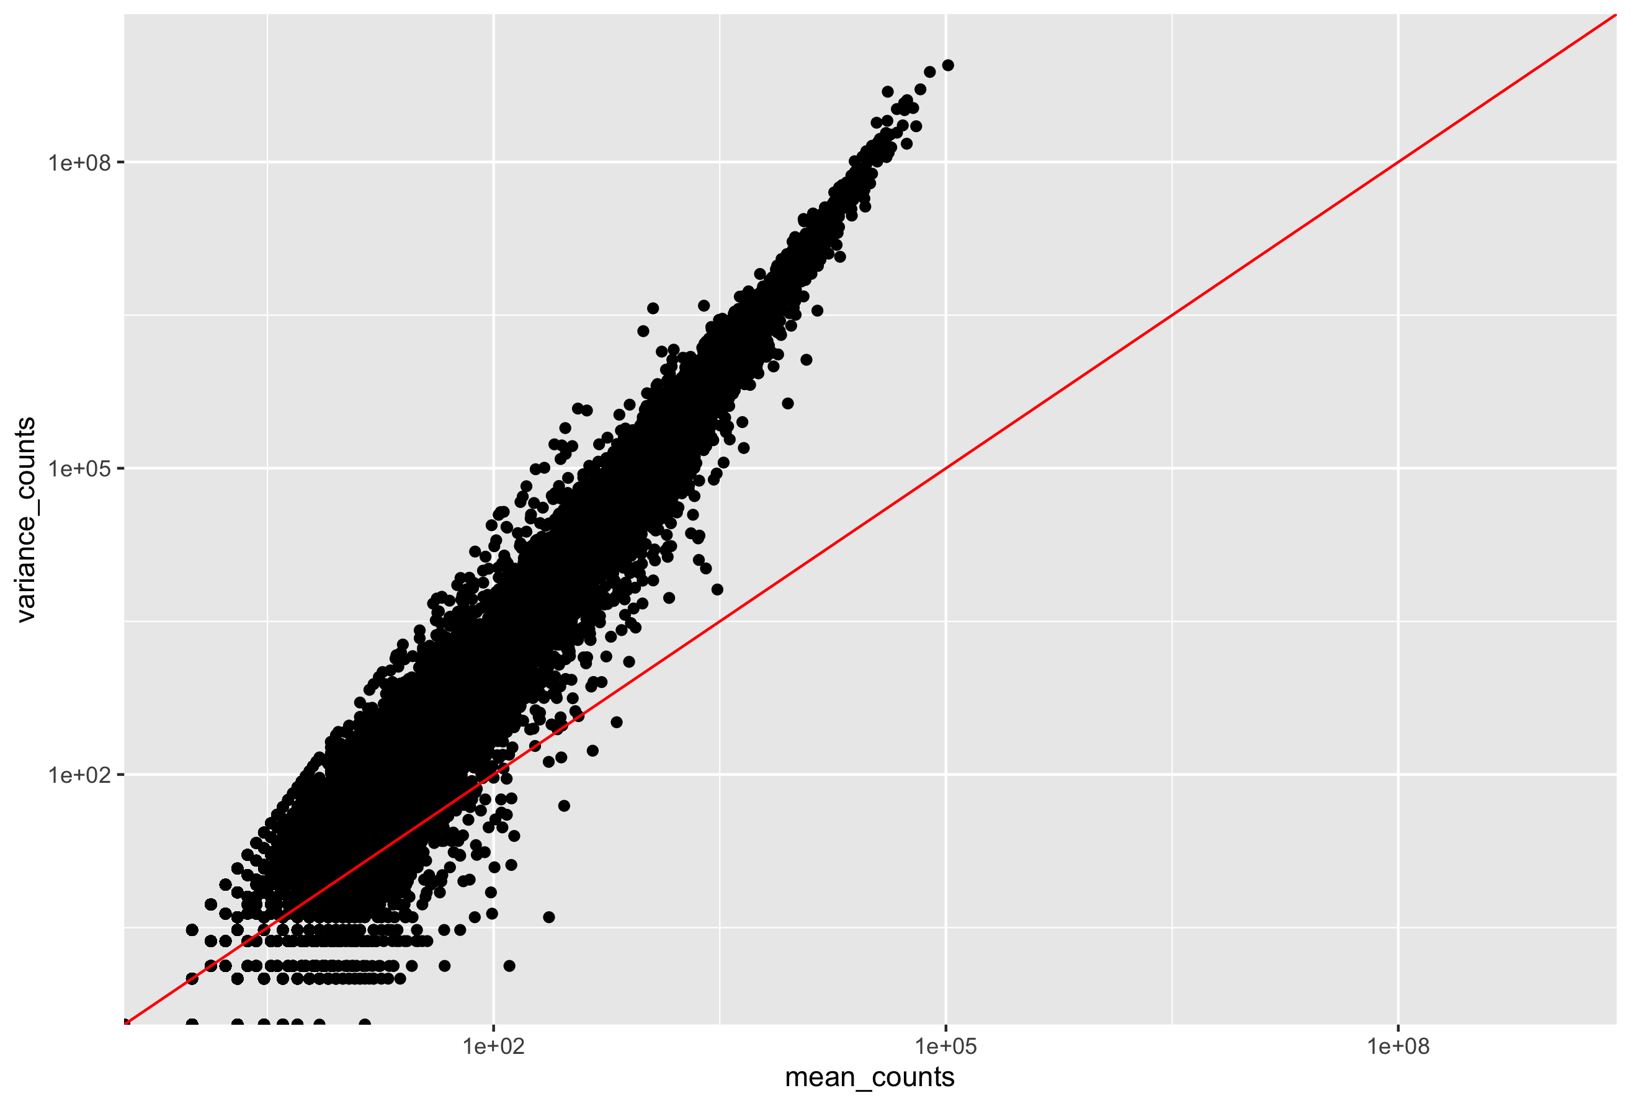
Modeling count data– why we don't still use the Poisson distribution
Mean vs Variance of three samples
The mean is not equal to the variance (the scatter of data points does not fall on the diagonal).
For the genes with high mean expression, the variance across replicates tends to be greater than the mean (scatter is above the red line).
For the genes with low mean expression we see quite a bit of scatter. We usually refer to this as “heteroscedasticity”. That is, for a given expression level in the low range we observe a lot of variability in the variance values.
BNFO 262 Winter 2026
Notes:
Source: https://hbctraining.github.io/DGE_workshop_salmon_online/lessons/01c_RNAseq_count_distribution.html

Slide 24
Modeling count data– why we don't still use the Poisson distribution
Negative binomial
BNFO 262 Winter 2026
Notes:
Script:
Negative binomial which does not assume mean is equal to variance, and takes into account dispersion.
If the proportions of mRNA stayed exactly constant between the biological replicates for a sample group, we could expect a Poisson distribution (where mean == variance). However, we always expect some amount of variability between replicates (we’ll discuss this in more detail later in the lesson). Alternatively, if we continued to add more replicates (i.e. > 20) we should eventually see the scatter start to reduce and the high expression data points move closer to the red line. So in theory, if we had enough replicates we could use the Poisson.
The distribution that fits RNA-seq data best, given this type of variability between replicates, is the Negative Binomial. Essentially, the Negative Binomial is a good approximation for data where the mean < variance, as is the case with RNA-Seq count data.
Additional replicates: as you add more data, you get increasingly precise estimates of group means, and ultimately greater confidence in the ability to reliably distinguish differences between sample classes.
Figure and information:
https://www.bioconductor.org/help/course-materials/2014/CSAMA2014/2_Tuesday/lectures/DESeq2-Anders.pdf
https://rna.colostate.edu/2019/lib/exe/fetch.php?media=181204_deseq2_slides.pdf
https://support.bioconductor.org/p/74572/
A distributional assumption is needed because we want to estimate the probability of extreme events (large fold change just appearing by chance) from limited replicates. The negative binomial (a.k.a. Gamma-Poisson) is a good choice for RNA-seq experiments because the observed data at gene level is inherently counts or estimated counts of fragments for each feature and
the spread of values among biological replicates is more than given by a simpler, one parameter distribution, the Poisson; and it seems to be captured by the NB sufficiently well
http://bridgeslab.sph.umich.edu/posts/why-do-we-use-the-negative-binomial-distribution-for-rnaseq
Two distributions for count based data are poisson (which presumes the variance and mean [ie expression in our case] are equal) or negative binomial (which does not). This is especially a problem when the number of biological replicates are low because it is hard to accurately model variance of count based data if you are looking at only that gene and making the assumptions of normally distributed continuous data (ie a t-test). A good estimate of variance for each gene is essential to determine whether the changes are due to chance.
Most RNAseq tools allow for the global variance (ie for a gene in 'general') to be estimated for a certain read density. This generates a more accurate estimate of the variance than looking at each individual gene's (potentially small n) distribution because you can make some assumptions in general about how low expressing and high expressing genes vary.
This variance parameter is then used to model the NB distribution for each gene (because it allows for expression and variance to be unlinked) and therefore to more accurately estimate the error term. As the number of samples increases, the local (gene-specific) variance can be better estimated (but the expression will generally follow a skewed, stochastic and non-normal distribution).

Slide 25
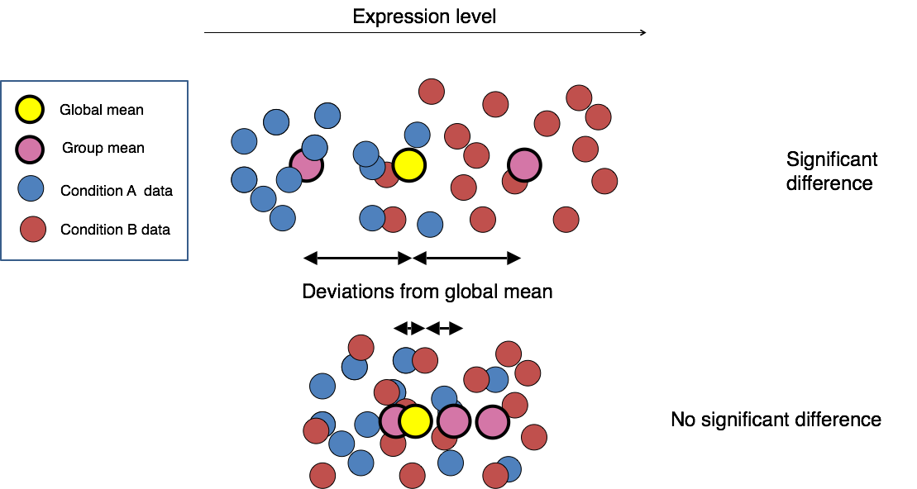
Differential Expression Analysis with DESeq2
Estimate size factors
Estimate gene-wise dispersion
Fit curve to gene-wise dispersion
Shrink gene-wise dispersion
GLM fit for each gene
Test for differential expression
Two lines of code in DESeq2 do everything above:
Create DESeq object
Run analysis with DESeq(dds)
BNFO 262 Winter 2026
Notes:
Source: https://hbctraining.github.io/DGE_workshop/lessons/04_DGE_DESeq2_analysis.html

Slide 26
Differential Expression Analysis with DESeq2
Estimate size factors: normalizes count data using the median ratios method = counts divided by sample-specific size factors determined by median ratio of gene counts relative to geometric mean per gene.
https://hbctraining.github.io/DGE_workshop/lessons/02_DGE_count_normalization.html
Takes sequencing depth and RNA composition into account but not gene length so not good for gene A vs gene B comparisons within a sample
Estimate size factors
Estimate gene-wise dispersion
Fit curve to gene-wise dispersion
Shrink gene-wise dispersion
GLM fit for each gene
Test for differential expression
BNFO 262 Winter 2026

Slide 27
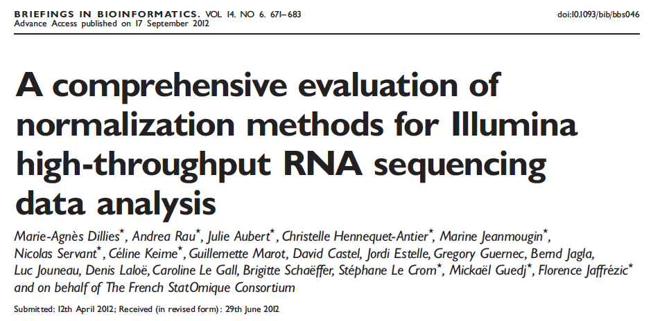
Normalization
Compared 7 methods of normalization (including DESeq2 and edgeR-TMM)
Differences are most apparent when there are large differences in library size between samples
Presence of few high-count genes and large number of 0 counts affect normalization
DESeq2 and edgeR-TMM had low false positive rate and high power (methods of choice)
BNFO 262 Winter 2026
Notes:
Script:
-Paper evaluating different normalization methods. There are other papers by other authors.
-In this paper, 7 methods of normalization with different datasets (mRNA and miRNA)
-Library size, presence of few high count and large number of 0 counts affects normalization
-DESeq2 and TMM “best” methods
Information:
Dillies et al. Briefings in Bioinformatics, Vol. 14 (6): 671–683 (2013)
https://exrna.org/normalization-of-small-rna-seq-data-from-extracellular-rna-samples/
Authors suggest DESeq2 and TMM as methods of choice based on different library sizes and composition
Dillies et al. published another comparison of normalization methods for RNAseq data in about the same time frame. Most of the datasets used were long RNAseq data, but a murine microRNA dataset was included. The seven methods compared in this study included TC (total counts), UQ (Upper Quartile), Median, DEseq, TMM, quantile and RPKM. TC, UQ and median are scaling approaches that are quite similar, involving the calculation of a scaling factor based on either the ratio of total counts (TC), upper quartile of counts (UQ) or median of counts. The authors assessed these normalization methods on real as well as simulated data. In their analysis, it is apparent that when boxplots of counts before and after normalization are assessed, the differences are most apparent in conditions where there are large differences in library size between samples. These differences do not improve after TC and RPKM normalization of the microRNA-seq data. Other features of microRNA-seq data that influence the results of the normalization according to the authors are the presence of high-count genes and a large number of 0 counts. Quantile normalization increases the intra-condition variability in the murine miRNA data. Based on the results of differential expression in this study, it is apparent that the differences in the final results depend on the normalization method and not on the model chosen to assess for differential expression (DESeq or TSPM). In the simulated data, which contains high count genes and may resemble microRNA seq data more closely than the other datasets, only DESeq and TMM were successful in achieving a low false positive rate and high power. The authors conclude that DESeq and TMM are the methods of choice based on their ability to perform in the presence of different library sizes and composition.

Slide 28
Differential Expression Analysis with DESeq2
Estimate size factors
Estimate gene-wise dispersion
Fit curve to gene-wise dispersion
Shrink gene-wise dispersion
GLM fit for each gene
Test for differential expression
Estimate gene-wise dispersion: Dispersion is a measure of the spread or variability in the data
The DESeq2 dispersion estimates are inversely related to the mean and directly related to variance. Based on this relationship, the dispersion is higher for small mean counts and lower for large mean counts.
The dispersion estimates for genes with the same mean will differ only based on their variance. Therefore, the dispersion estimates reflect the variance in gene expression for a given mean value.
BNFO 262 Winter 2026

Slide 29
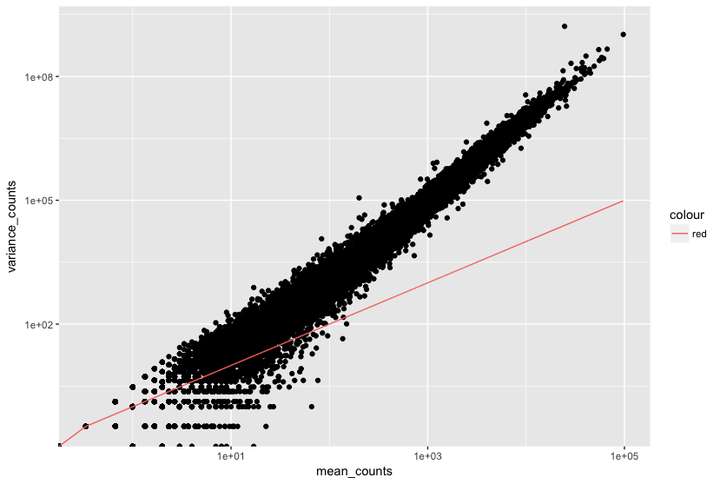
Differential Expression Analysis with DESeq2
For low mean counts, the variance estimates have a much larger spread; therefore, the dispersion estimates will differ much more between genes with small means.
We care about "within-group" variation. With just a small # of replicates (2-5) it is not possible so DESeq2 shares information across genes by assuming genes with similar expression levels have similar dispersion.
BNFO 262 Winter 2026

Slide 30
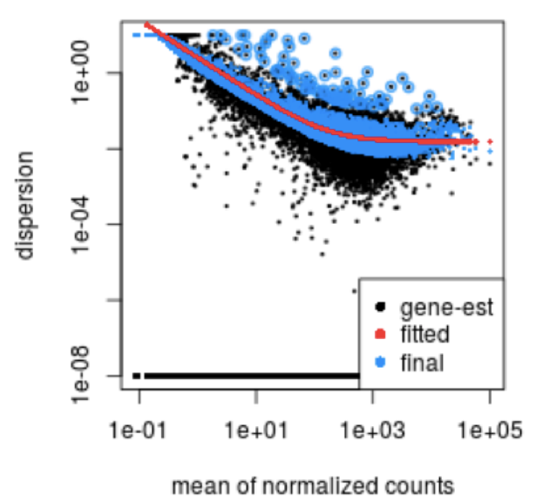
Differential Expression Analysis with DESeq2
Estimate size factors
Estimate gene-wise dispersion
Fit curve to gene-wise dispersion
Shrink gene-wise dispersion
GLM fit for each gene
Test for differential expression
Curve fitting gives reasonable estimate of dispersion in experiment
BNFO 262 Winter 2026

Slide 31
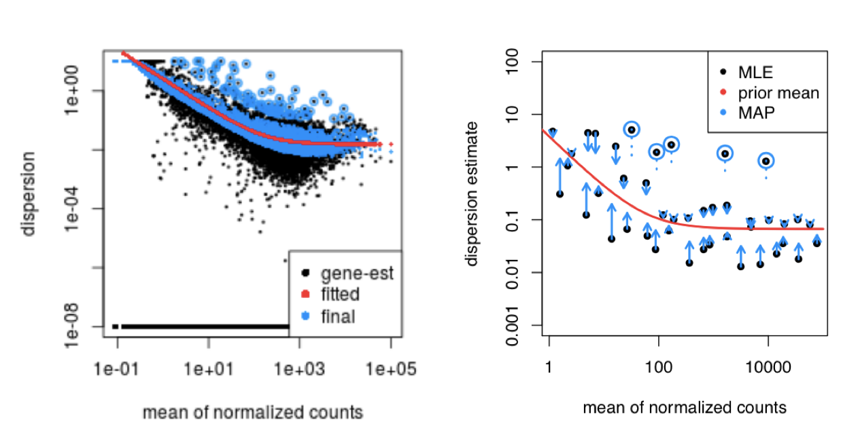
Differential Expression Analysis with DESeq2​
Estimate size factors
Estimate gene-wise dispersion
Fit curve to gene-wise dispersion
Shrink gene-wise dispersion
GLM fit for each gene
Test for differential expression
Shrink gene-wise dispersion estimates: gene dispersions are shrunk towards the curve unless very high and then not shrunk to reduce false positives
BNFO 262 Winter 2026

Slide 32
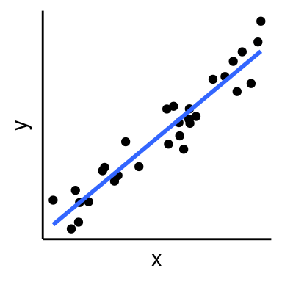
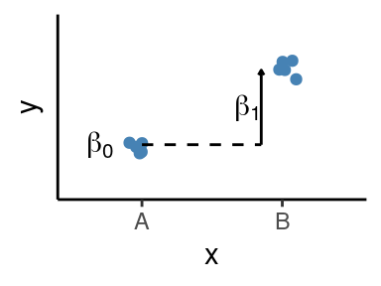
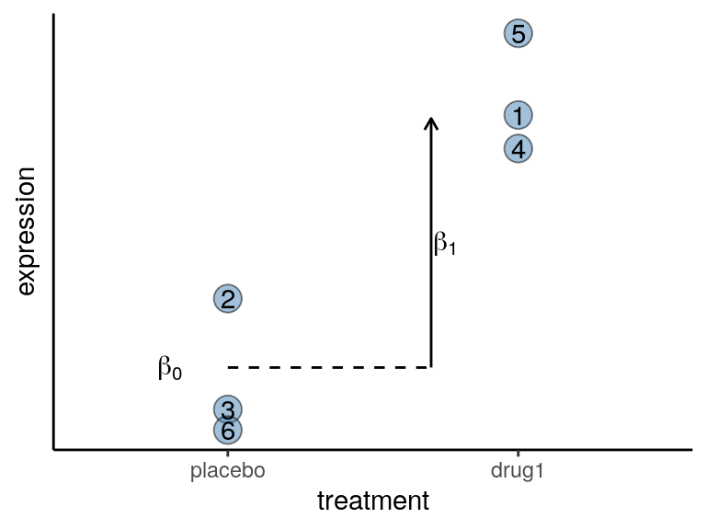
Differential Expression Analysis with DESeq2​
Estimate size factors
Estimate gene-wise dispersion
Fit curve to gene-wise dispersion
Shrink gene-wise dispersion
GLM fit for each gene
Test for differential expression
General Linear Model (GLM): similar to linear regression with an observed variable (y – dependent variable/gene expression) that is influenced by an independent variable (x – categorical factors)
BNFO 262 Winter 2026
Notes:
Source: https://bioinformatics-core-shared-training.github.io/Bulk_RNAseq_Course_2021_June/Markdowns/09_Linear_Models.html

Slide 33
DESeq2 and edgeR: RNA-Seq Tutorials
http://bioconductor.org/packages/release/bioc/vignettes/DESeq2/inst/doc/DESeq2.html
https://lashlock.github.io/compbio/R_presentation.html
https://genviz.org/module-04-expression/0004/02/01/DifferentialExpression/
http://www.nathalievialaneix.eu/doc/html/solution_edgeR-tomato-withcode.html
https://web.stanford.edu/class/bios221/labs/rnaseq/lab_4_rnaseq.html
https://www.bioconductor.org/packages/release/bioc/vignettes/edgeR/inst/doc/edgeRUsersGuide.pdf
https://www.ncbi.nlm.nih.gov/pmc/articles/PMC4937821/pdf/f1000research-5-18347.pdf
BNFO 262 Winter 2026
Notes:
Tutorials with practice datasets and code. Code from the class notebooks can be used for long RNA too.

Slide 34
Differences in DEA programs are partly due to differences in normalization
Normalization method | Description | Accounted factors | Recommendations for use
CPM (counts per million) | Counts scaled by total number of reads | Sequencing depth | Gene count comparisons between replicates of the same sample group; NOT for within sample comparisons or DE analysis
DESeq2’s median of ratios | Counts divided by sample-specific size factors determined by median ratio of gene counts relative to geometric mean per gene | Sequencing depth and RNA composition | Gene count comparisons between samples and for DE analysis; NOT for within sample comparisons
EdgeR’s Trimmed Mean of M values (TMM) | Uses a weighted trimmed mean of the log expression ratios between samples | Sequencing depth, RNA composition, and gene length | Gene count comparisons between and within samples and for DE analysis
BNFO 262 Winter 2026
Notes:
Information:
https://pubmed.ncbi.nlm.nih.gov/22988256/
https://www.biostars.org/p/284775/
https://hbctraining.github.io/DGE_workshop/lessons/02_DGE_count_normalization.html
DESeq: This normalization method [14] is included in the DESeq Bioconductor package (version 1.6.0) [14] and is based on the hypothesis that most genes are not DE. (Assuming one sample per lane) A DESeq scaling factor for a given lane is computed as the median of the ratio, for each gene, of its read count over its geometric mean across all lanes. The underlying idea is that non-DE genes should have similar read counts across samples, leading to a ratio of 1. Assuming most genes are not DE, the median of this ratio for the lane provides an estimate of the correction factor that should be applied to all read counts of this lane to fulfill the hypothesis. By calling the estimateSizeFactors() and sizeFactors() functions in the DESeq Bioconductor package, this factor is computed for each lane, and raw read counts are divided by the factor associated with their sequencing lane.
Trimmed Mean of M-values (TMM): This normalization method [17] is implemented in the edgeR Bioconductor package (version 2.4.0). It is also based on the hypothesis that most genes are not DE. The TMM factor is computed for each lane, with one lane being considered as a reference sample and the others as test samples. For each test sample, TMM is computed as the weighted mean of log ratios between this test and the reference, after exclusion of the most expressed genes and the genes with the largest log ratios. According to the hypothesis of low DE, this TMM should be close to 1. If it is not, its value provides an estimate of the correction factor that must be applied to the library sizes (and not the raw counts) in order to fulfill the hypothesis. The calcNormFactors() function in the edgeR Bioconductor package provides these scaling factors. To obtain normalized read counts, these normalization factors are re-scaled by the mean of the normalized library sizes. Normalized read counts are obtained by dividing raw read counts by these re-scaled normalization factors.
Quantile (Q): First proposed in the context of microarray data, this normalization method consists in matching distributions of gene counts across lanes [22, 23]. It is implemented in the Bioconductor package limma [31] by calling the normalizeQuantiles() function.

Slide 35
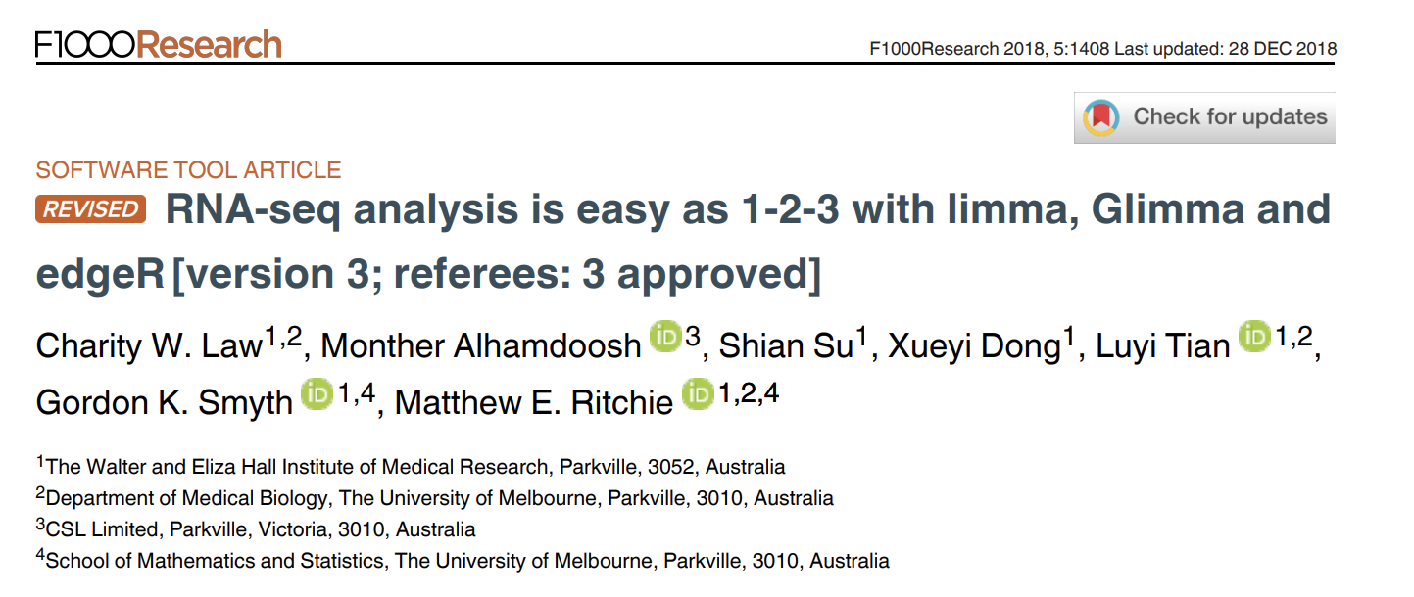
Limma, Glimma and edgeR
https://www.ncbi.nlm.nih.gov/pmc/articles/PMC4937821/
BNFO 262 Winter 2026

Slide 36
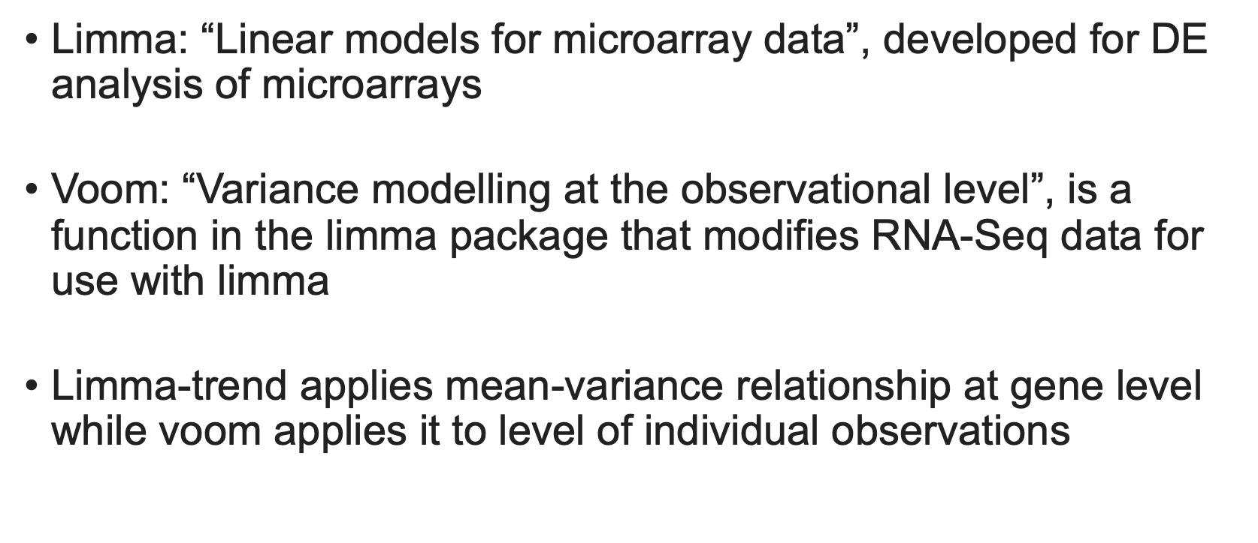
Limma-voom
BNFO 262 Winter 2026
Notes:
https://ucdavis-bioinformatics-training.github.io/2018-June-RNA-Seq-Workshop/thursday/DE.html#:~:text=limma%20is%20an%20R%20package,analyses%20of%20RNA%2DSeq%20data.
limma is an R package that was originally developed for differential expression (DE) analysis of microarray data. voom is a function in the limma package that modifies RNA-Seq data for use with limma. Together they allow fast, flexible, and powerful analyses of RNA-Seq data.
https://genomebiology.biomedcentral.com/articles/10.1186/gb-2014-15-2-r29#:~:text=We%20call%20the%20first%20method,the%20level%20of%20individual%20observations.
We call the first method limma-trend and the second method voom, an acronym for 'variance modeling at the observational level'. limma-trend applies the mean-variance relationship at the gene level whereas voom applies it at the level of individual observations.

Slide 37
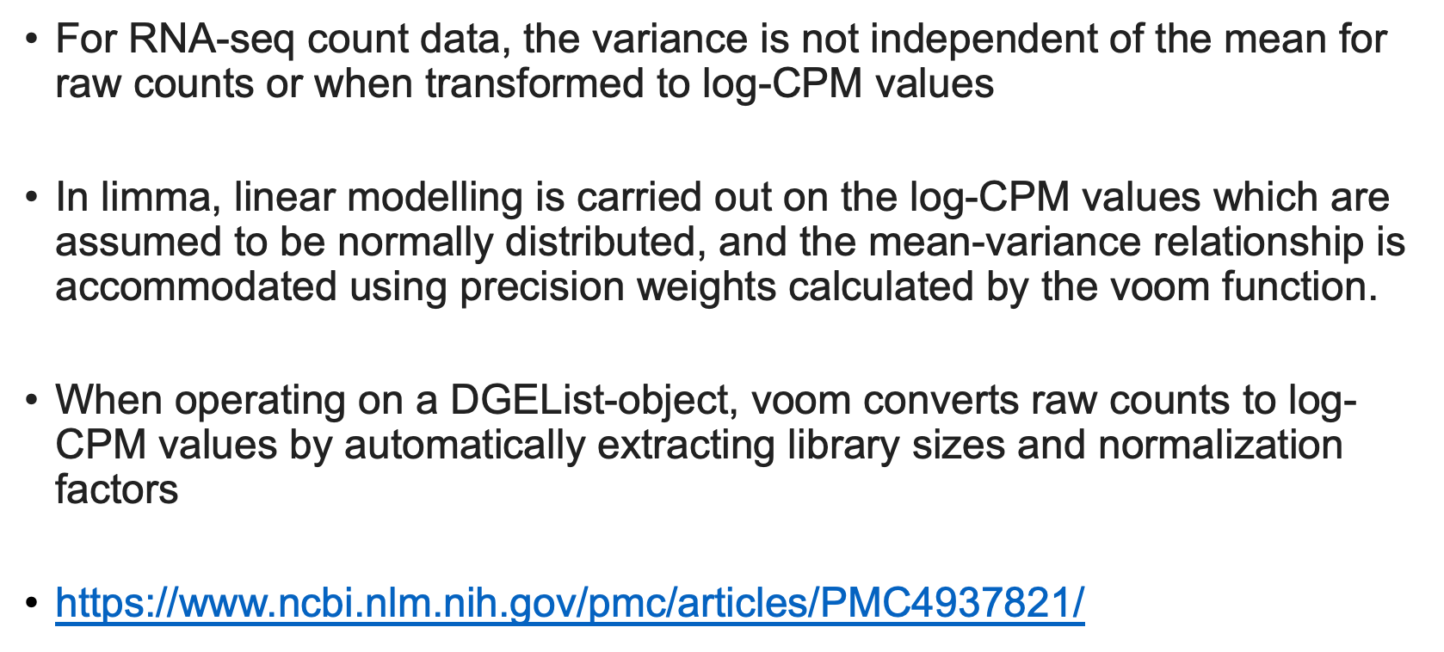
Limma-voom
BNFO 262 Winter 2026
Notes:
​​Voom:
Transform count data to log2-counts per million (logCPM), estimate the mean-variance relationship and use this to compute appropriate observation-level weights. The data are then ready for linear modelling.
https://rdrr.io/bioc/limma/man/voom.html
Raw counts show increasing variance with increasing count size, while log-counts typically show a decreasing mean-variance trend. This function estimates the mean-variance trend for log-counts, then assigns a weight to each observation based on its predicted variance. The weights are then used in the linear modelling process to adjust for heteroscedasticity.
Heteroscedasticity: standard deviations of a predicted variable, monitored over different values of an independent variable or as related to prior time periods, are non-constant.
https://rdrr.io/bioc/limma/man/voom.html
This function is intended to process RNA-seq or ChIP-seq data prior to linear modelling in limma.
voom is an acronym for mean-variance modelling at the observational level. The idea is to estimate the mean-variance relationship in the data, then use this to compute an appropriate precision weight for each observation. Count data always show marked mean-variance relationships. Raw counts show increasing variance with increasing count size, while log-counts typically show a decreasing mean-variance trend. This function estimates the mean-variance trend for log-counts, then assigns a weight to each observation based on its predicted variance. The weights are then used in the linear modelling process to adjust for heteroscedasticity.
voom performs the following specific calculations. First, the counts are converted to logCPM values, adding 0.5 to all the counts to avoid taking the logarithm of zero. The matrix of logCPM values is then optionally normalized. The lmFit function is used to fit row-wise linear models. The lowess function is then used to fit a trend to the square-root-standard-deviations as a function of an average log-count measure. The trend line is then used to predict the variance of each logCPM value as a function of its fitted value on the count scale, and the inverse variances become the estimated precision weights.

Slide 38
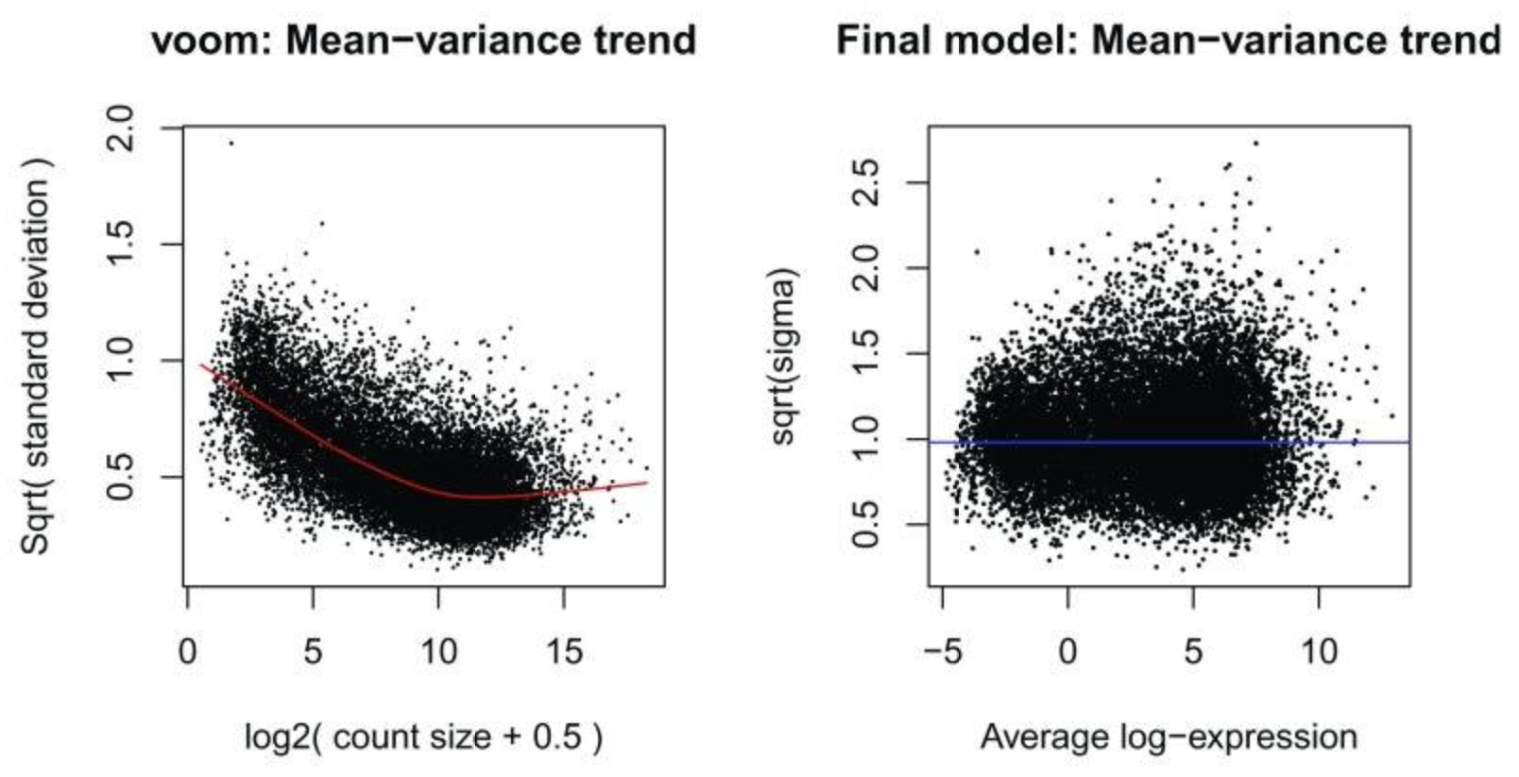
Mean-variance relationship of log-CPM values
https://www.ncbi.nlm.nih.gov/pmc/articles/PMC4937821/
BNFO 262 Winter 2026
Notes:
-Each dot represents a gene and it shows the mean-variance relationship of the genes in the dataset. This plot can help show if low counts have been filtered adequately and if there is a lot of variation in the data.
-The “voom-plot” shows a decreasing trend between the means and variances resulting from a combination of technical variation in the sequencing experiment and biological variation amongst the replicate samples from different cell populations. Experiments with high biological variation usually result in flatter trends, where variance values plateau at high expression values. Experiments with low biological variation tend to result in sharp decreasing trends.
-Linear modelling in limma is carried out using the lmFit and contrasts.fit functions originally written for application to microarrays. SA Plot (sigma vs. A plot) shows residual standard deviation versus average log expression for a fitted microarray linear model. Variance is no longer dependent on the mean expression level. The average log2 residual standard deviation is marked by a horizontal blue line. This plot shows how the dependence between the means and variances has been removed after the voom weights are applied to the data.
Why use it?
-Reduces false positives, is fast to run, effectively detects outliers in the data, reduces heteroscedasticity, allows incorporation of metadata (experimental design, treatment conditions, replicates).
Means (x-axis) and variances (y-axis) of each gene are plotted to show the dependence between the two before voom is applied to the data ( A) and how the trend is removed after voom precision weights are applied to the data ( B). The plot on the left is created within the voom function which extracts residual variances from fitting linear models to log-CPM transformed data. Variances are then rescaled to quarter-root variances (or square-root of standard deviations) and plotted against the mean expression of each gene. The means are log ₂-transformed mean-counts with an offset of 2. The plot on the right is created using plotSA which plots log ₂ residual standard deviations against mean log-CPM values. The average log ₂ residual standard deviation is marked by a horizontal blue line. In both plots, each black dot represents a gene and a red curve is fitted to these points.
-https://training.galaxyproject.org/training-material/topics/transcriptomics/tutorials/rna-seq-counts-to-genes/tutorial.html#:~:text=Voom%20variance%20plot,-This%20plot%20is&text=Each%20dot%20represents%20a%20gene,Voom%20variance%20plots%20box%20below.
-https://www.ncbi.nlm.nih.gov/pmc/articles/PMC4937821/
-https://doi.org/10.1186/gb-2014-15-2-r29

Slide 39
A comment on miRNA-Seq Analysis
Non-normal distribution of expression of different small RNAs, particularly miRNAs
Few miRNAs account for large fraction of total reads while majority contribute a small percentage (large number of 0 reads)
Extracellular RNA sample input amounts are extremely limited
Increased potential for sampling error and experimental bias
BNFO 262 Winter 2026
Notes:
Information:
Dillies et al. Briefings in Bioinformatics, Vol. 14 (6): 671–683 (2013)
https://exrna.org/normalization-of-small-rna-seq-data-from-extracellular-rna-samples/
RNA-Seq experiments: Sources of systematic variation include library size, transcript length, and GC content (Dillies et al. 2012)

Slide 40
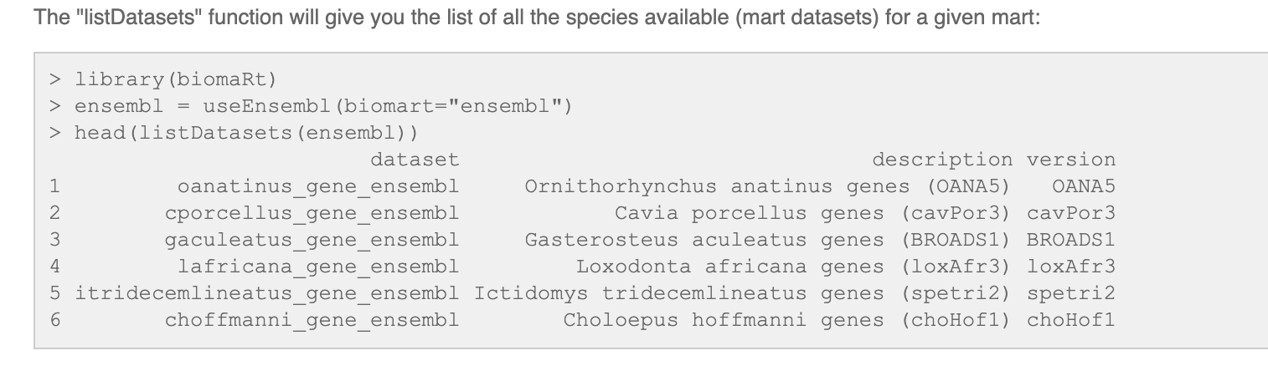
Other important tools: BiomaRt
Maintained by ENSEMBL
Gene annotations, database mining
https://bioconductor.org/packages/release/bioc/html/biomaRt.html
https://uswest.ensembl.org/info/data/biomart/biomart_r_package.html
BNFO 262 Winter 2026

Slide 41
Biological Interpretation
miRNAs: miRDB- target prediction
mRNAs:
Biomart for gene symbols
DAVID
GO (gene ontology) annotations and KEGG networks analysis
IPA Ingenuity Pathways Analysis
BNFO 262 Winter 2026

Slide 42

Break: 10 min
BNFO 262 Winter 2026

Slide 43
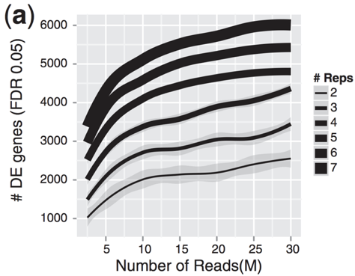
Exercise: DE analysis using mRNA counts data from Star and Salmon with DESeq2 and edgeR + TMM – how many replicates do we need?
BNFO 262 Winter 2026
Bioinformatics, Volume 30, Issue 3, February 2014

Slide 44
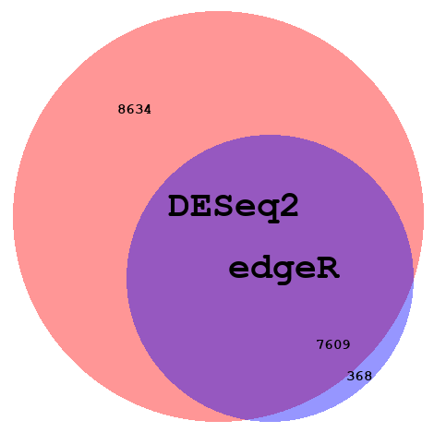
Overlap in DE miRNAs using DESeq2 and TMM
BNFO 262 Winter 2026
Notes:
https://mikelove.wordpress.com/2016/09/28/deseq2-or-edger/
What’s different then?
The major differences between the two methods are in some of the defaults. DESeq2 by default does a couple things (which can all optionally be turned off): it finds an optimal value at which to filter low count genes, flags genes with large outlier counts or removes these outlier values when there are sufficient samples per group (n>6), excludes from the estimation of the dispersion prior and dispersion moderation those genes with very high within-group variance, and moderates log fold changes which have small statistical support (e.g. from low count genes).
edgeR offers similar functionality, for example, it offers a robust dispersion estimation function, estimateGLMRobustDisp, which reduces the effect of individual outlier counts, and a robust argument to estimateDisp so that hyperparameters are not overly affected by genes with very high within-group variance. And the default steps in the edgeR User Guide for filtering low counts genes both increases power by reducing multiple testing burden and removes genes with uninformative log fold changes.

Slide 45
Exercise: mRNA-Seq Differential Expression Analysis using edgeR with limma-voom
BNFO 262 Winter 2026

Slide 46
Thank You!
A/Prof. Alon Goren
Teaching Assistants:
Jenny Dong
Yuwei Cao
BNFO 262 Winter 2026

Slide 47
Supplemental slides

Slide 48
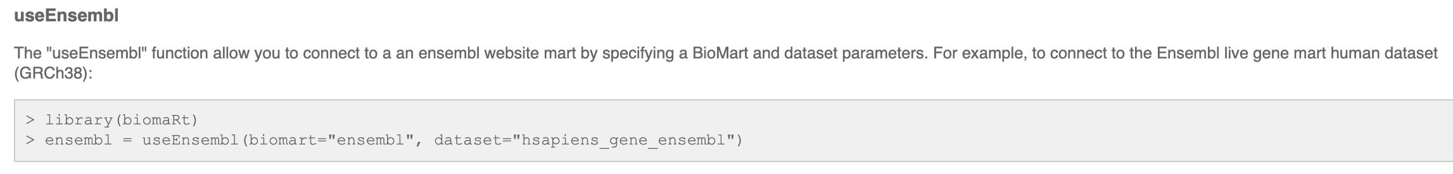
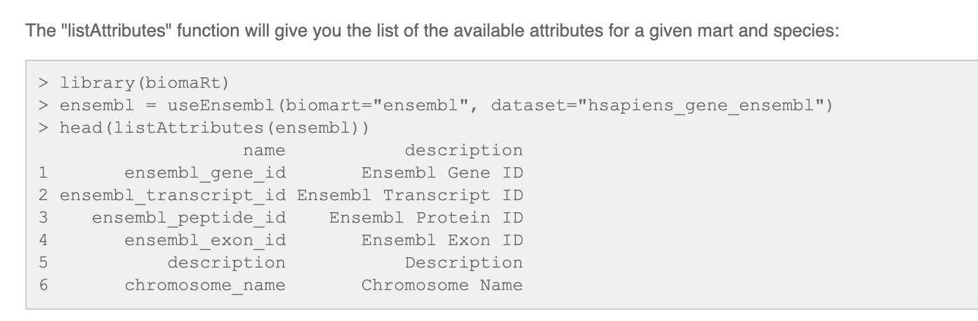
BiomaRt
https://uswest.ensembl.org/info/data/biomart/biomart_r_package.html
BNFO 262 Winter 2026
Notes:
https://uswest.ensembl.org/info/data/biomart/biomart_r_package.html

Slide 49
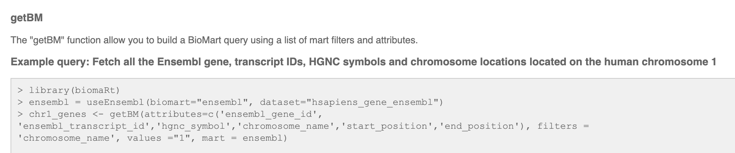
BiomaRt
https://uswest.ensembl.org/info/data/biomart/biomart_r_package.html
BNFO 262 Winter 2026

